Slide 1
Horizon EU project no.101112838, under the Soil Mission topic: Building the mission's knowledge repository and advancing the European Soil Observatory (EUSO).
An open access knowledge and data repository to safeguard soils
Thaïsa van der Woude, ISRIC

Slide 2
Stakeholder meeting
Thaïsa van der Woude, ISRIC
19-09-2024

Slide 3
Meeting logistics
Meeting will be recorded and added to website
  please turn off your camera if you don’t to be recorded
Keep your microphone muted until Q&A
You can add your questions in the chat
  the SoilWise team will answer them directly
Goal of meeting is to provide the status of the project.
  Feedback on the SoilWise repository will be done in 2025

Slide 4
Agenda
11:30-11:35 Welcome & Opening / Introduction - Thaïsa van der Woude (ISRIC)
11:35-11:45 Overview of the Project
and connection to other projects (10 minutes) - Fenny van Egmond (ISRIC)
11:15-11:25 Showcase prototype (10 min) - Paul van Genuchten (ISRIC)
11:55-12:05 The importance of engagement and
ways to interact with the project (10 min) - Isidora Stojacic (BioSense)
12:05-12:10 Stakeholder involvement poll (survey) - Isidora Stojacic (BioSense)
12:10-12:25 Q&A Session - Thaïsa van der Woude (ISRIC)
12:25-12:30 Wrap-up and Closing Remarks - Thaïsa van der Woude (ISRIC)

Slide 5
Overview of the Project
Fenny van Egmond, ISRIC
19-09-2024

Slide 6
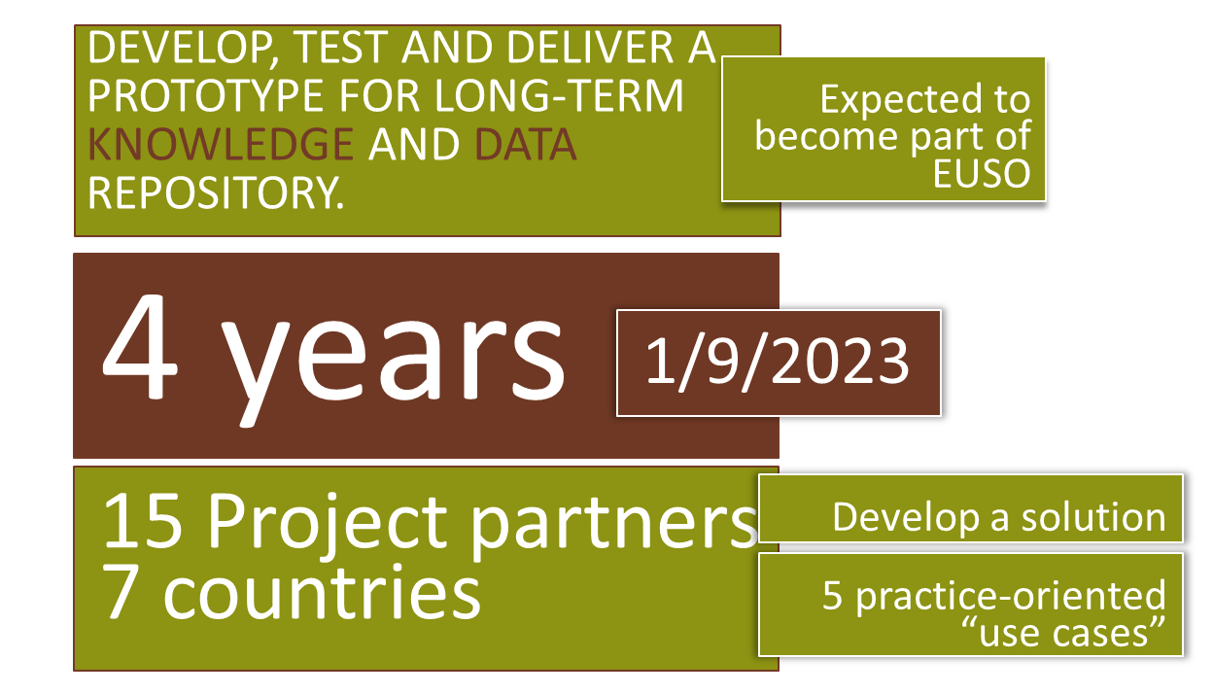
What is the SoilWise project?

Slide 7
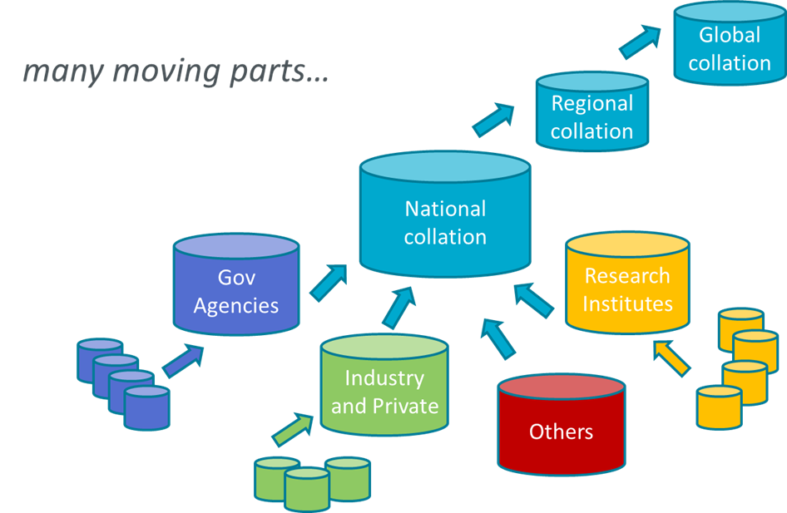
Why the SoilWise project?
Soil information is needed to answer many current questions
But it is not easy to find
Not easy to access
Is not standardised or harmonised
Therefore, using data or knowledge can be costly or challenging

Slide 8
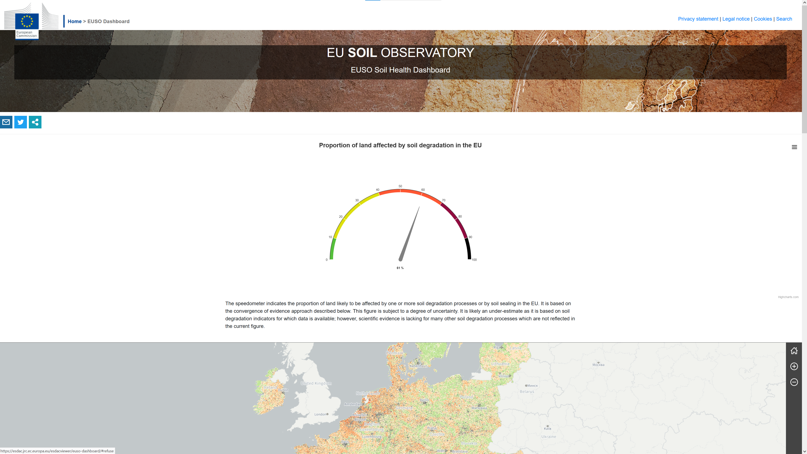


The proposal to remedy this
DG JRC
DG REA
DG AGRI
EU Soil Observatory
(EUSO)
between 36 to 100 Mission Soil
Horizon Europe projects with
data, knowledge and wishes
SoilWise Repository (SWR)
stakeholder groups

Slide 9

What are the plans?
X
Project SoilWise intention is:
SoilWise intention is NOT:
to provide a single access point to soil data and knowledge
to index available data & knowledge
to establish catalog federation
to make your (data and knowledge) life easier
to copy & store your data
to control your data
to steal your data
to use your data without your permission

Slide 10

Main message
To develop a useful and functional Soil Data and Knowledge Infrastructure, the collaboration efforts (and benefits from the outcomes) need to be mutual for all involved stakeholders (EUSO and Mission Soil Horizon projects' end-users included)

Slide 11
The SoilWise Repository -
easily findable, accessible, interoperable and reusable in the long-term
a multi-actor co-design and co-validation processes
all key user groups and R&I (Research and Innovation) outcomes
strategies for soil data and knowledge collection, processing, visualization and exploitation
Common ground for countries, the European Commission and other stakeholders
Achieve healthy soils in 2050 and ensure broad uptake and implementation by land managers, policy, research and industry.

Slide 12
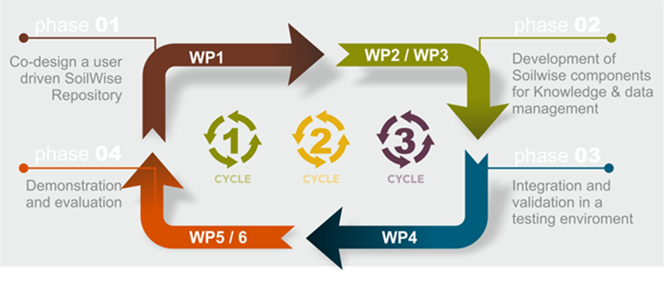
Iterative structure
September 2023 – August 2027

Slide 13
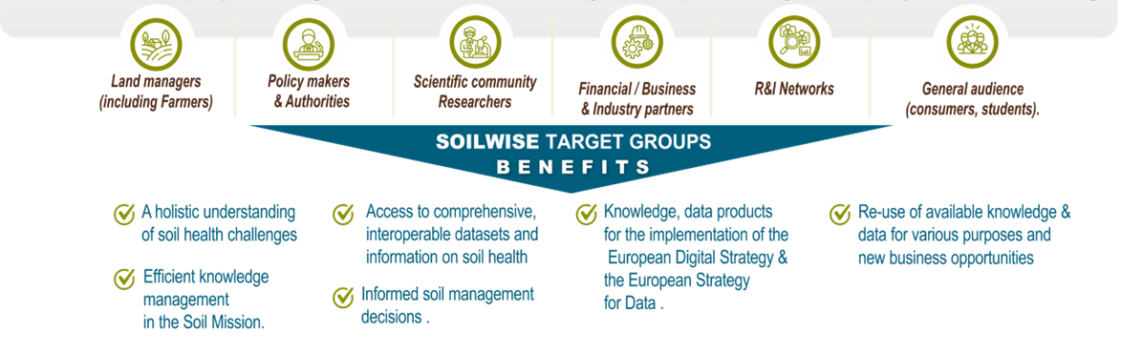
For whom?
For the EU Soil Observatory (EUSO)

Slide 14
What is in it for you?
One place to look for knowledge and data about soil
Improved search, standardisation and findability of information about soil, FAIR
By providing feedback you help us create a platform that fits your needs as a data provider and/or a data user
This platform can help you in your every-day work whenever you need to use soil information
This platform can facilitate collaboration between organisations, networks, people

Slide 15
Showcase prototype
- a first snapshot
Paul van Genuchten, ISRIC
19-09-2024

Slide 16
Find Access Interoperate Reuse
Knowledge
Information
Data
Business
Government
Academia

Slide 17
A single discovery experience
Requires:
Mechanisms to import from various sources
Harmonize metadata models
Clustering of sources (filters)
Ranking mechanisms (which source is more relevant)
Maintain (or establish) linkage between sources
Establish trustworthiness
How can we do better than a generic search engine?

Slide 18
Ease of use
Typical catalogue behaviour; search, list and detail
A chatbot which helps to find a relevant resource
A chatbot which provides a direct answer to your question

Slide 19
Ease of use – part 2
Open the dataset to view its content
Extract a citation to a source dataset to be included in an article
Understand if I can use that dataset for my business case
How can I contribute a new resource
Integrate 2 datasets into a single dataset
When can I conclude that a resource I’m looking for does not exist
I want to inform the platform of a problem in the content

Slide 20
Soilwise is not a repository
Soilwise does not aim to persist resources for eternity
Use trustworthy repositories such as National, University, Dataverse, Zenodo, etc…
If Soilwise/OpenAire/INSPIRE is aware of that repository, it will automatically pick up the resource

Slide 21
Harvest and Harmonise
Zenodo
ISRIC
EJP SOIL
Dataverse
Copernicus
Impact4soil
OpenAire
National portals
National portals
FAO
BonaRes
Cordis
INSPIRE
EEA
ESDAC
SoilWise Catalogue

Slide 22
SWR Endpoints
Catalogue
Oai-pmh
CSW
STAC
Opensearch
RDF
SPARQL
DC & SKOS
Chatbot
prompt

Slide 23
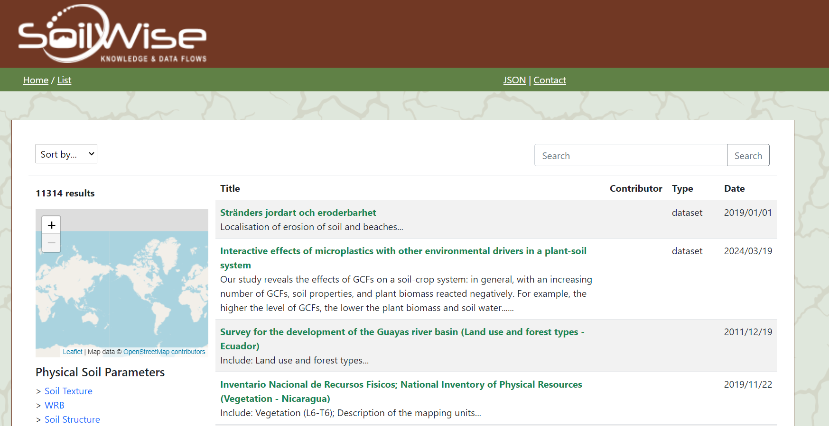
Catalogue

Slide 24
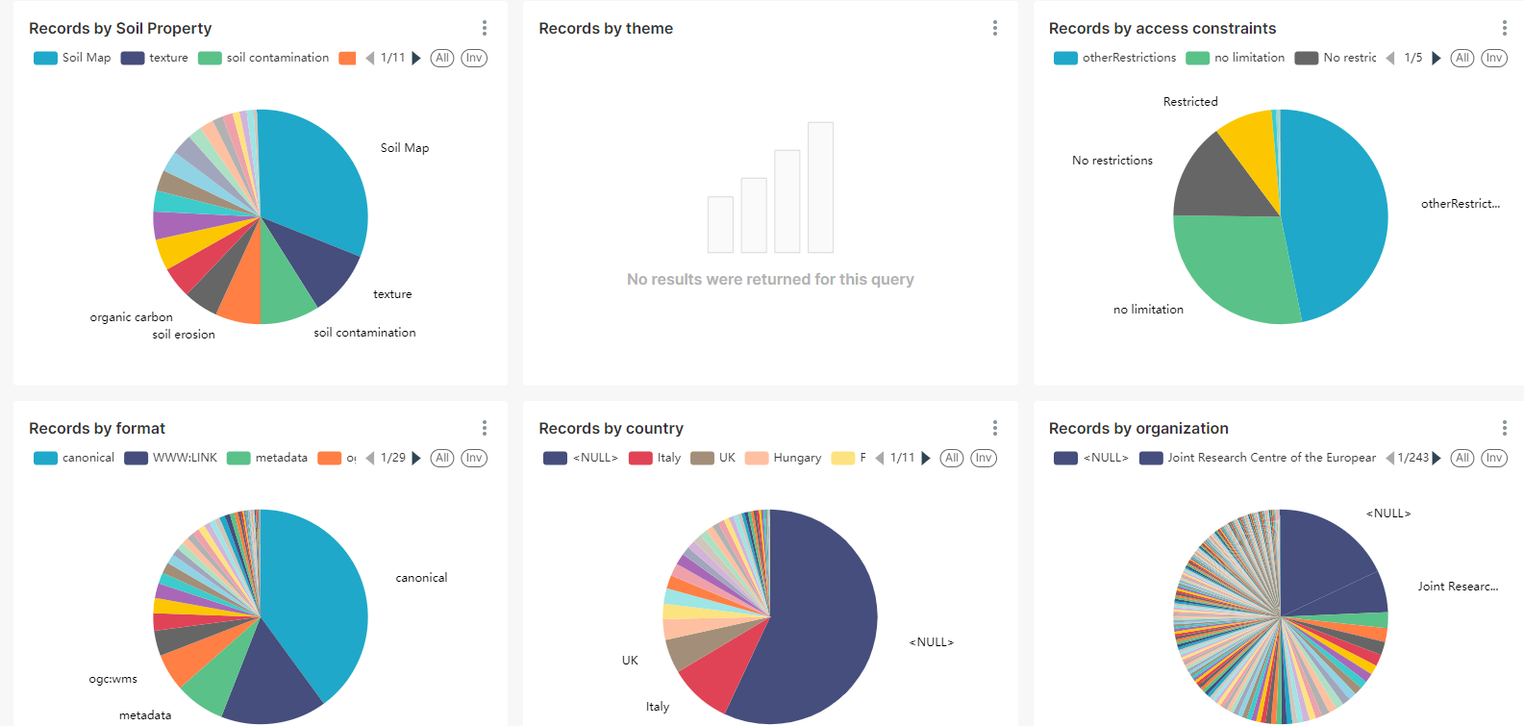
Dashboard

Slide 25
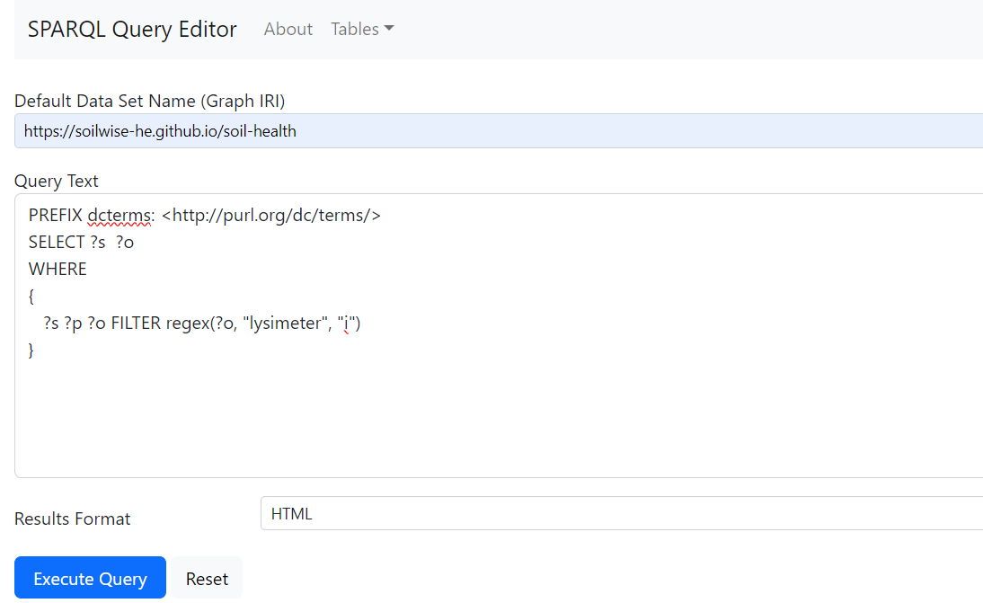
RDF

Slide 26
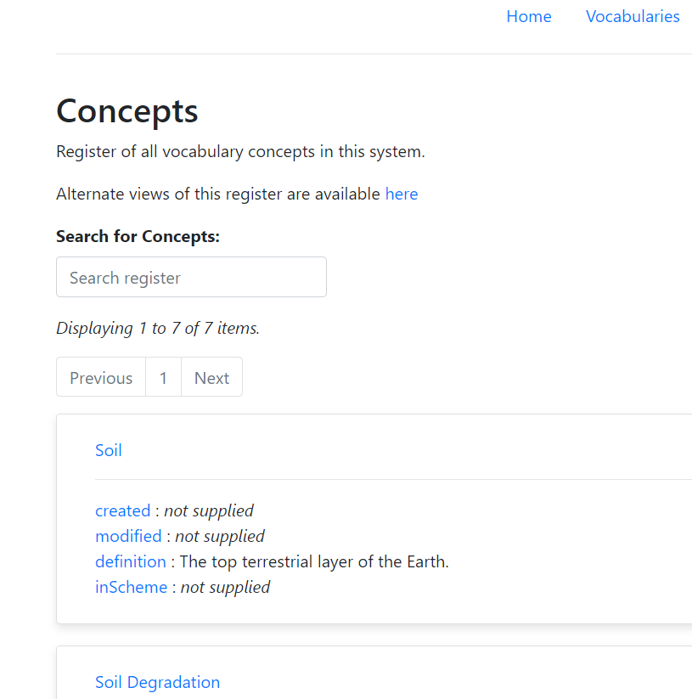
Data harmonisation
Hale Studio
A Soil Geopackage template
A Glossary and Code list repository

Slide 27
Development and Configuration via Github
A community platform is best managed via an open platform
We propose Github, but it may evolve to Gitlab/Bitbucket/…
Aspects managed via the public github channels:
  Tasks, including assignment/prioritisation
  Discussions & user feedback
  Documentation
  Software source code
  Metadata and harvester authoring
  Platform configuration (docker build scripts, deployment pipelines)
The project repository is located at github.com/soilwise-he

Slide 28
Stakeholder engagement
Isidora Stojacic, BioSense
19-09-2024

Slide 29
Aims and interaction with stakeholders
What we would like to achieve
What we offer to interact with us
Engage stakeholders to inform and validate the project’s direction (SWR).
Facilitate knowledge exchange between different actors related to soil (soil data).
Ensure that stakeholders' needs and concerns are integrated into the project
Gain feedback and create value for stakeholders
Communication Channels: website, newsletters, social media
Engagement: SW Demonstrations of the platform, Mission Soil Cluster events
Repeating Workshops: Frequent workshops and regional events to gather ongoing feedback.

Slide 30
Which type of stakeholder are you?
Mission Soil Cluster Data
But also:
Data provider
Data user
Or both?

Slide 31
Providing feedback in the project for the first cycle and beyond
Test and validate with Stakeholders
Demo events with Stakeholders
SWR MVP
Requirements for the next iteration

Slide 32
Let us know which activities are of interest to you!
Goals for SoilWise as a project and as a repository:
To set an interactive stakeholder network
Facilitate scientists, policy makers, authorities, land managers and other interested parties
Jointly guided informed decision-making on soil towards the 2030 goals of the Green Deal.
Ways to interact?
Join our workshops and webinars
Complete surveys
Provide information on your activities
Training sessions
Other
Get link
Survey - in the chat

Slide 33
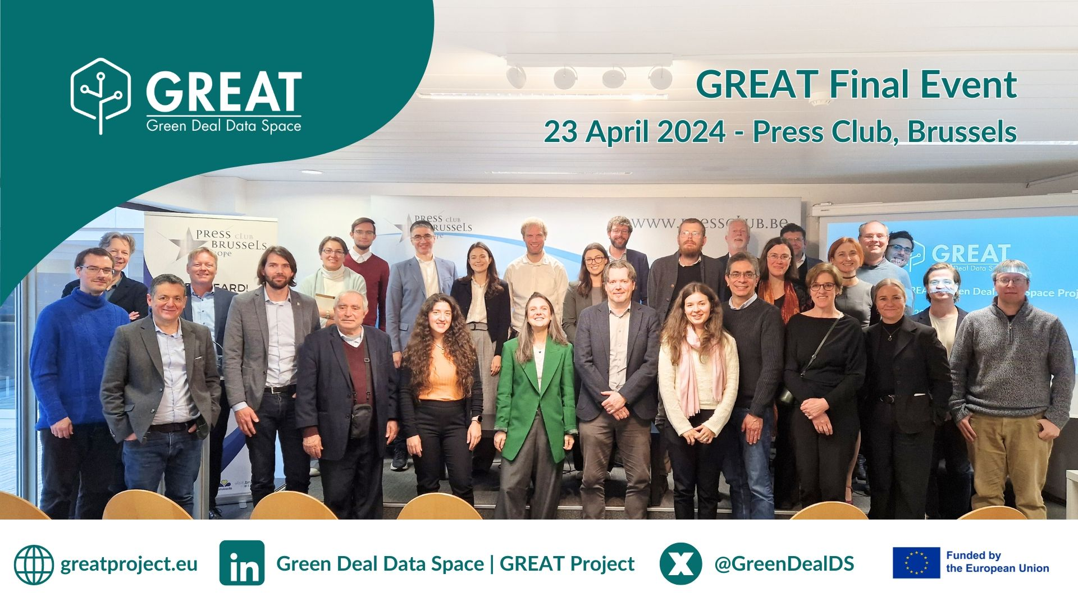
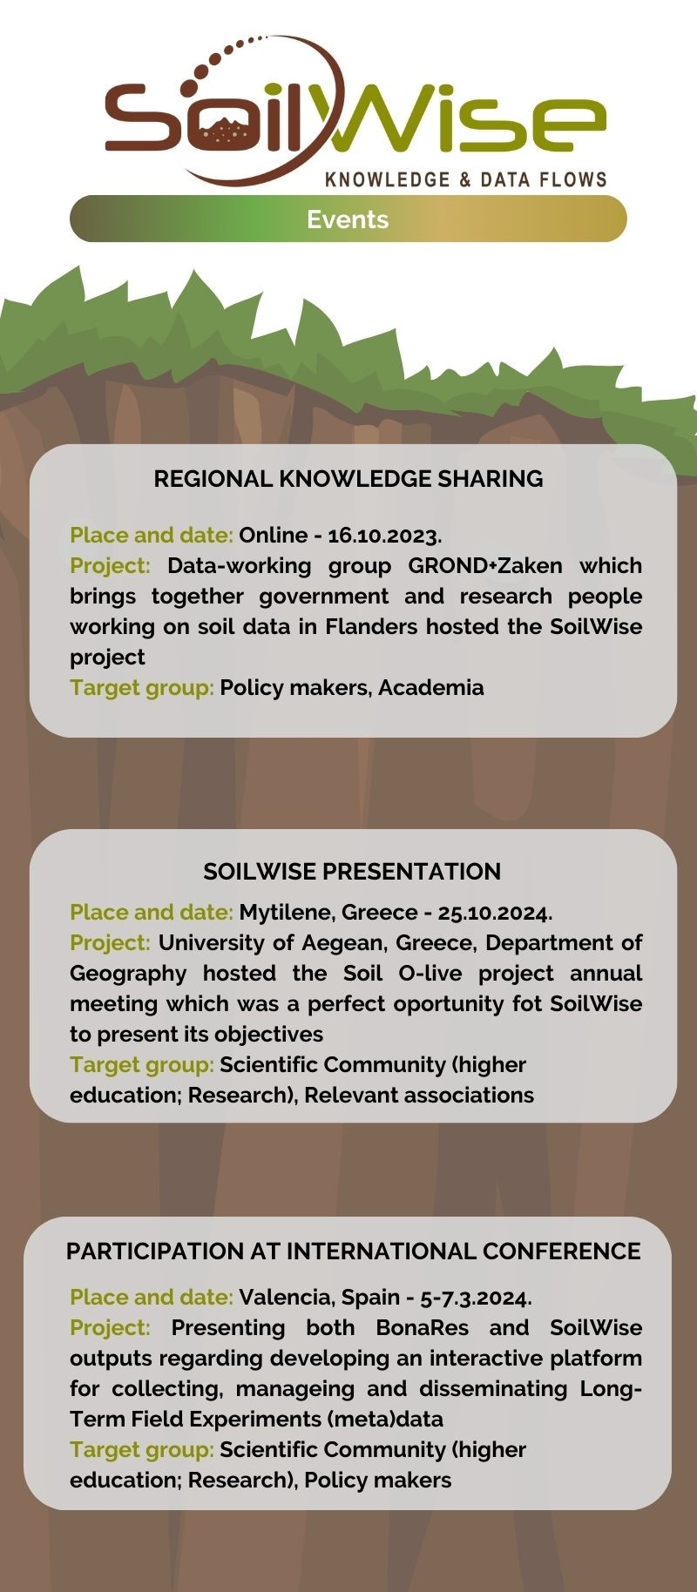
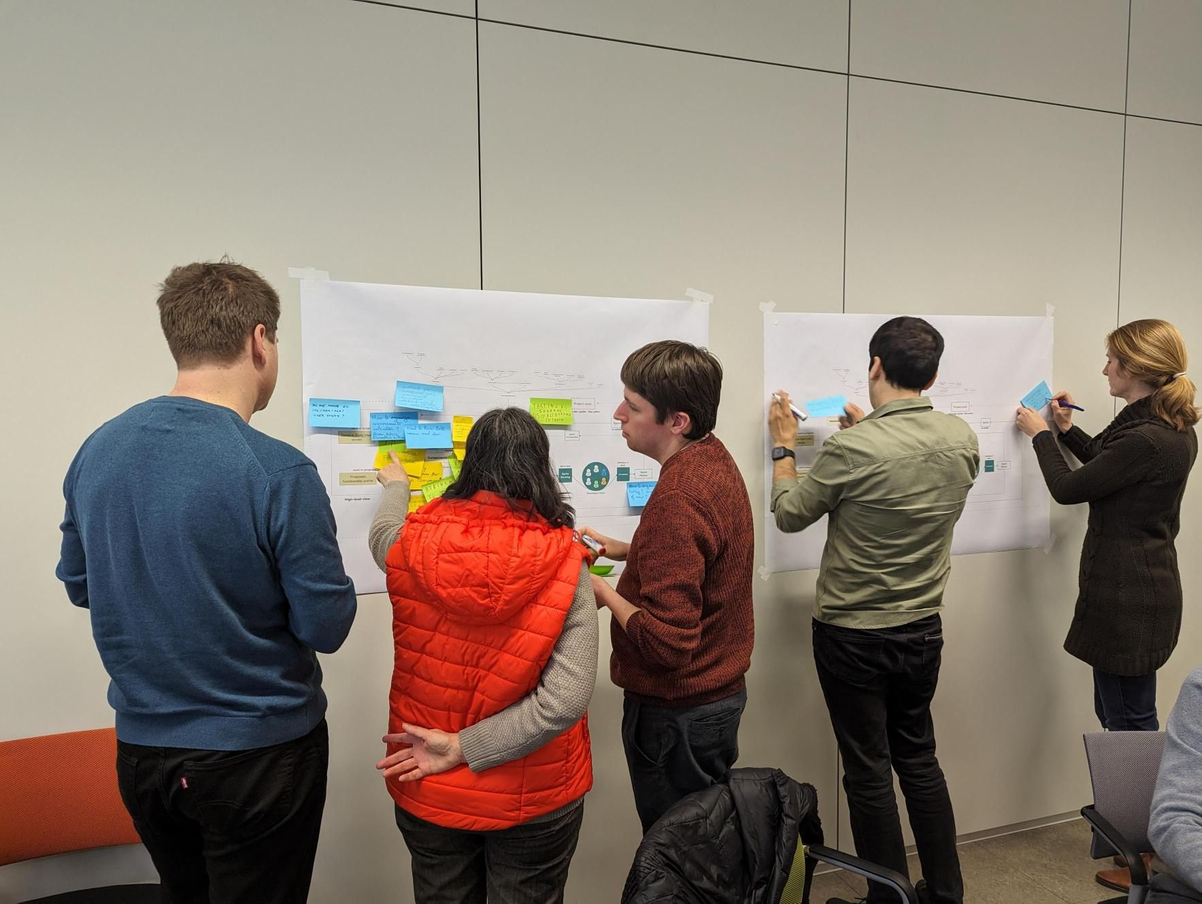

Where can you find us in the next period?
FAO Global Symposium on Soil Information and Data, Nanjing, China (September 25-28).
Open Living Lab days, Timisoara, Romania (September 25-27).

Slide 34



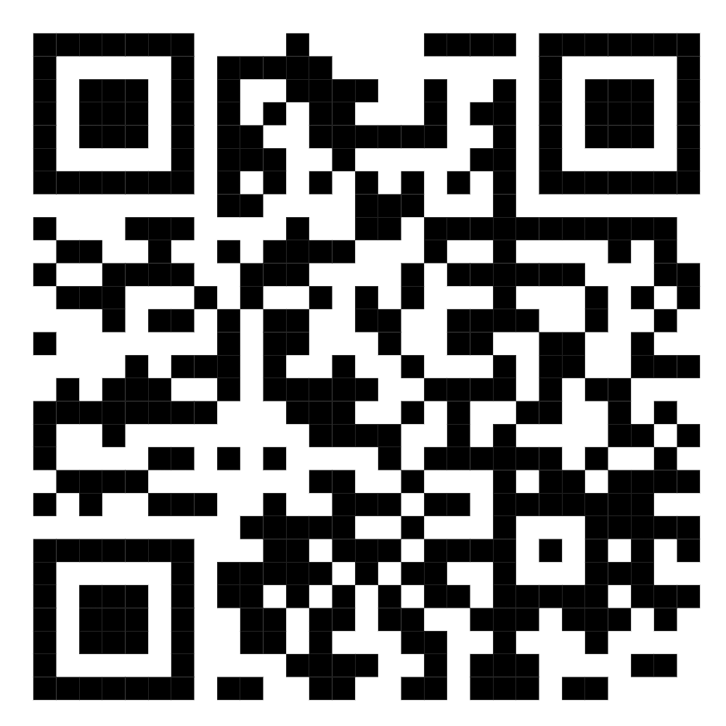
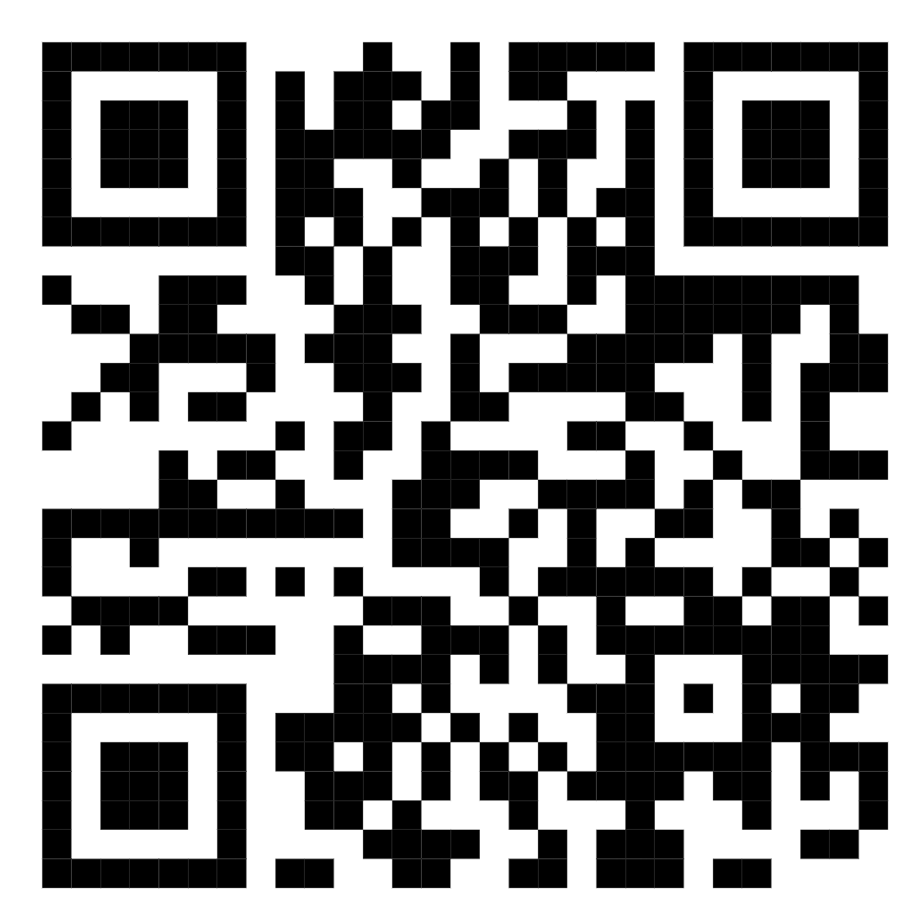
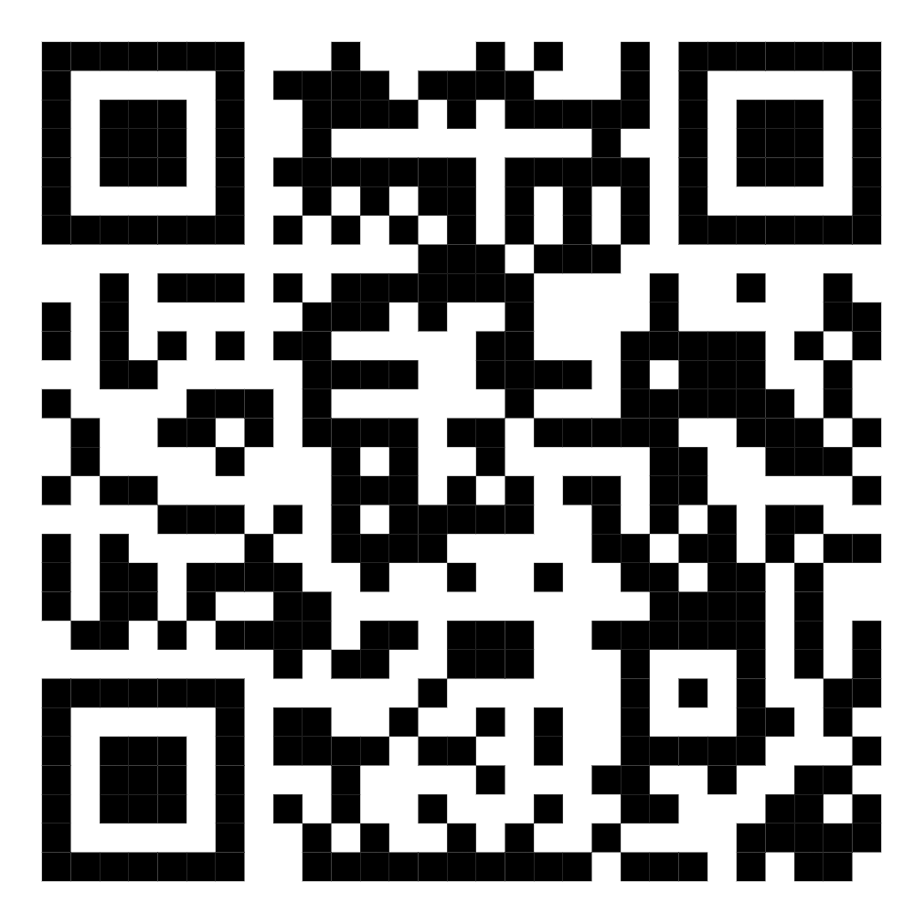
SoilWise social media accounts
Website: soilwise-he.eu
Search: SoilWise Project
SoilWise Project
@SoilWiseproject

Slide 35
Stakeholder involvement poll
Isidora Stojacic, BioSense
19-09-2024

Slide 36
Q&A
Thaïsa van der Woude, ISRIC
19-09-2024

Slide 37
Closing
Thaïsa van der Woude, ISRIC
19-09-2024

